Slide 1
Annual General Meeting 2023
04.05.2023

Slide 2
AGENDA
Opening of the meeting
Appoint the chairman of the meeting, a secretary for the meeting, the two persons to approve the meeting minutes, and if necessary, two persons to count the votes
Declare the meeting has been correctly called and represents a quorum
Approve meeting agenda
Present the annual report of the association from the previous term
Present the association accounts from the previous term along with auditor’s note of approval
Decide on the discharge of liability for the Executive Committee
Decide annual activity action plan, budget, and membership fee for annual year 2023 based on the presentation from the Executive Committee
Appoint alumni association president and other members of the Executive Committee
Choose one or two auditors and a deputy auditor
Other items mentioned in the meeting invitation

Slide 3
AGENDA
Opening of the meeting
Appoint the chairman of the meeting, a secretary for the meeting, the two persons to approve the meeting minutes, and if necessary, two persons to count the votes
Declare the meeting has been correctly called and represents a quorum
Approve meeting agenda
Present the annual report of the association from the previous term
Present the association accounts from the previous term along with auditor’s note of approval
Decide on the discharge of liability for the Executive Committee
Decide annual activity action plan, budget, and membership fee for annual year 2023 based on the presentation from the Executive Committee
Appoint alumni association president and other members of the Executive Committee
Choose one or two auditors and a deputy auditor
Other items mentioned in the meeting invitation

Slide 4
Annual report of the association from the previous term 2022-2023
Alumni Events
Alumni meeting point on May 1 with champagne
INSEAD NAA Finland 25 anniversary celebration on Friday June 3
LBS Alumni club event: National Dance Company of Korea on September 23
Visit to FIBAN pitching on September 27
High Psychological Safety – speaker event on November 9
LBS Alumni club event: New ways of working and the future of the workplace on November 17
Current Financial Markets turmoil explained by professor Pekka Hietala on January 11
New graduate event on January 25
Alumni Visit to Finnish National Opera with Turandot on January 31
Alumni Ball 2023 on March 10
Other Alumni Activity
Annual General Meeting on April 21 was held as online meeting
IN-BOARD NORDIC ACADEMY 2022 in August-October by NAA Norway
Participating joint European alumni associations effort to provide shelter for refugees from Ukraine
Promoting INSEAD Alumni Fund in annual XMASS letter, but decided not to arrange special Giving Day activity
Did not arrange Global INSEAD Day event
Extensive Lifelong learning Webinar supply from International Alumni Association and from the school
Admin
Alumni association ExCo met four times during 2022
Membership penetration level target of 60 members, or more, was achieved
Membership fee payment with MobilePay is growing popularity
Recurring payments to INSEAD Alumni Fund have been cleared

Slide 5
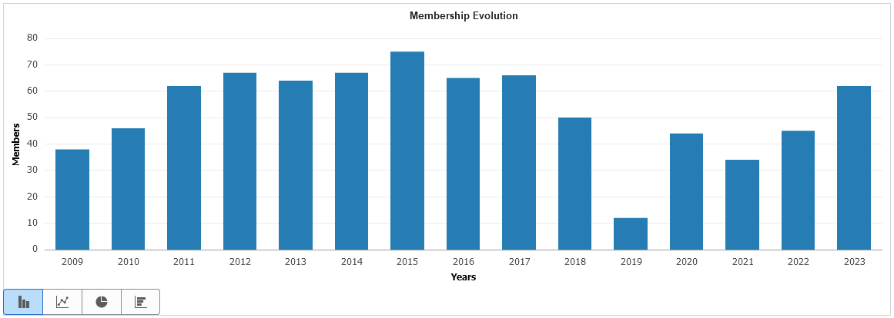
Membership Evolution

Slide 6
Membership Evolution

Slide 7
AGENDA
Opening of the meeting
Appoint the chairman of the meeting, a secretary for the meeting, the two persons to approve the meeting minutes, and if necessary, two persons to count the votes
Declare the meeting has been correctly called and represents a quorum
Approve meeting agenda
Present the annual report of the association from the previous term
Present the association accounts from the previous term along with auditor’s note of approval
Decide on the discharge of liability for the Executive Committee
Decide annual activity action plan, budget, and membership fee for annual year 2023 based on the presentation from the Executive Committee
Appoint alumni association president and other members of the Executive Committee
Choose one or two auditors and a deputy auditor
Other items mentioned in the meeting invitation

Slide 8
Alumni association accounts summary per month from 2022
Income
Membership fees (payment methods: bank transfer, MobilePay, MyInsead Alumni Portal) +3 424€
Expenses
Alumni & partnership events & activity costs (25yrs anniversary dinner, Vappu picnic, Opera drinks) -xxx€
NAA/NAC annual contribution -xxx€
Annual newsletter -xxx€
Alumni volunteers meeting Fontainebleau 2022 -xxx€
ExCo meetings (three meetings in 2022) -xxx€
Bank (Handelsbanken) service costs -xxx€
Total 2022: -xxx€
Cash balance 31 Dec 2022: +xxx€
Additional notes:
Donations: We have not been allowed to send donations since 2020 – please reach back if you want to reimburse! The correct channel for donations is: https://forceforgood.insead.edu/give
Double memberships payments: we are checking but not always with 100% accuracy – please reach back if you want us to doublecheck!
We strongly encourage to use https://my.insead.edu/ for membership payments
Available on request for association members.
Auditor’s note of approval dated xx April 2023.
Full accounting and documents are available per request from riku.rintanen@insead.edu.

Slide 9
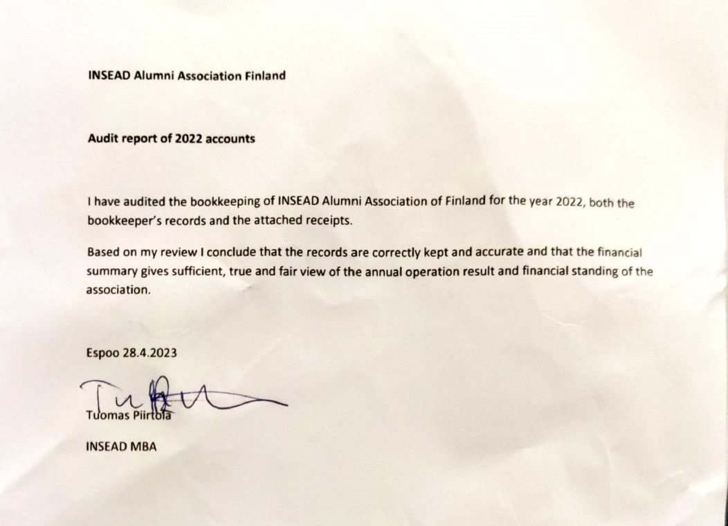
Auditor’s note of approval for 2022 accounting

Slide 10
AGENDA
Opening of the meeting
Appoint the chairman of the meeting, a secretary for the meeting, the two persons to approve the meeting minutes, and if necessary, two persons to count the votes
Declare the meeting has been correctly called and represents a quorum
Approve meeting agenda
Present the annual report of the association from the previous term
Present the association accounts from the previous term along with auditor’s note of approval
Decide on the discharge of liability for the Executive Committee
Decide annual activity action plan, budget, and membership fee for annual year 2023 based on the presentation from the Executive Committee
Appoint alumni association president and other members of the Executive Committee
Choose one or two auditors and a deputy auditor
Other items mentioned in the meeting invitation

Slide 11
AGENDA
Opening of the meeting
Appoint the chairman of the meeting, a secretary for the meeting, the two persons to approve the meeting minutes, and if necessary, two persons to count the votes
Declare the meeting has been correctly called and represents a quorum
Approve meeting agenda
Present the annual report of the association from the previous term
Present the association accounts from the previous term along with auditor’s note of approval
Decide on the discharge of liability for the Executive Committee
Decide annual activity action plan, budget, and membership fee for annual year 2023 based on the presentation from the Executive Committee
Appoint alumni association president and other members of the Executive Committee
Choose one or two auditors and a deputy auditor
Other items mentioned in the meeting invitation

Slide 12
Activity plan for 2023-2024
Alumni Events
Alumni meeting point on May 1st with champagne
IN-BOARD NORDIC ACADEMY 2023 in August-October by NAA Norway
Targeting 3 events in Autumn and three events in Spring
Other Alumni Activity
Promoting INSEAD Alumni Fund in annual XMASS letter
Global INSEAD Day - date and theme for 2023 coming in August
Admin
Target to keep membership penetration level over 60 members high target is 70+
Encourage new people to become active in arranging and hosting events
Several ExCo members reaching end of term and stepping down. Secure smooth transition for the new ExCo.

Slide 13
Cash flows summary 2015-2022
Accumulated surplus in 2020 & 2021 due to low activity (covid-19)
Memberships sustainably back on good level after the drop in 2018 (INSEAD memberships payment portal implementation challenges)
Mission: maximise events & other activities towards members sustainably year over year!
Any comments, questions, suggestions to the treasurer?
Available on request for association members.

Slide 14
AGENDA
Opening of the meeting
Appoint the chairman of the meeting, a secretary for the meeting, the two persons to approve the meeting minutes, and if necessary, two persons to count the votes
Declare the meeting has been correctly called and represents a quorum
Approve meeting agenda
Present the annual report of the association from the previous term
Present the association accounts from the previous term along with auditor’s note of approval
Decide on the discharge of liability for the Executive Committee
Decide annual activity action plan, budget, and membership fee for annual year 2023 based on the presentation from the Executive Committee
Appoint alumni association president and other members of the Executive Committee
Choose one or two auditors and a deputy auditor
Other items mentioned in the meeting invitation

Slide 15
NAA Finland Executive Committee
2022 ExCo
leaving
President Markku Komsi (EMBA´08) *
Treasurer Riku Rintanen (MBA06D) *
Board Member Jani Puroranta (MBA´05D) *
Board Member Jari Paakkarinen (IEP´99Apr) *
Board Member Richard Jerome (MBA´08J) *
Board Member Nilla Länsman (MBA’14J)
2023 ExCo

Slide 16
NAA Finland Executive Committee
2022 ExCo
President Markku Komsi (EMBA´08)
Treasurer Riku Rintanen (MBA06D)
Board Member Jani Puroranta (MBA´05D)
Board Member Jari Paakkarinen (IEP´99Apr)
Board Member Richard Jerome (MBA´08J)
Board Member Nilla Länsman (MBA’14J)
ExCo proposal for 2023 ExCo
President Jaani Pietikäinen (MBA´01J)
Board Member Tuomas Piirtola (MBA´06D)
Board Member Sofia Silberman-Hammer (MBA´21J)
Board Member Michel Mercier (CGM'19)
Board Member Nilla Länsman (MBA’14J)
Board Member Jari Paakkarinen (IEP´99Apr)

Slide 17
AGENDA
Opening of the meeting
Appoint the chairman of the meeting, a secretary for the meeting, the two persons to approve the meeting minutes, and if necessary, two persons to count the votes
Declare the meeting has been correctly called and represents a quorum
Approve meeting agenda
Present the annual report of the association from the previous term
Present the association accounts from the previous term along with auditor’s note of approval
Decide on the discharge of liability for the Executive Committee
Decide annual activity action plan, budget, and membership fee for annual year 2023 based on the presentation from the Executive Committee
Appoint alumni association president and other members of the Executive Committee
Choose one or two auditors and a deputy auditor
Other items mentioned in the meeting invitation

Slide 18
AGENDA
Opening of the meeting
Appoint the chairman of the meeting, a secretary for the meeting, the two persons to approve the meeting minutes, and if necessary, two persons to count the votes
Declare the meeting has been correctly called and represents a quorum
Approve meeting agenda
Present the annual report of the association from the previous term
Present the association accounts from the previous term along with auditor’s note of approval
Decide on the discharge of liability for the Executive Committee
Decide annual activity action plan, budget, and membership fee for annual year 2023 based on the presentation from the Executive Committee
Appoint alumni association president and other members of the Executive Committee
Choose one or two auditors and a deputy auditor
Other items mentioned in the meeting invitation

